Slide 1
Mrs. D’Onofrio & Ms.Aponte
Welcome to 2nd grade!
2021-2022

Slide 2
TONIGHT’S AGENDA:
*Getting to Know your child's teacher
*Our Philosophy and Goals
*Literacy Block/Writing
*Math Modules/ZEARN
*Grading System
*Daily Schedule
*Routines
*Behavior and Expectations
*Attendance Expectations
*Classwork Expectations
*Contacting your child's teacher :
*Odds and Ends/Questions/Concerns

Slide 3
2nd Grade
Team
Mrs. D’Onofrio
Ms. Aponte

Slide 4
Philosophies and Goals
*Every learner can be successful
*Be prepared & organized
*Open & on-going/daily communication: we’re a team!
*Have a schedule/routine
*Word of the year: PATIENCE

Slide 5
Hybrid: Track A, B, D
Track A: meets in person Mon & Tues, remote Wed-Fri
Track B: meets in person Thurs & Fri, remote Mon-Wed
Track D: 100% Virtual
*On remote days, students will continue accessing their assignments through Microsoft Teams & our other learning platforms.
*Please frequently check Class Dojo & the daily assignment sheet posted to Teams Files, Dojo messenger & our class homepages

Slide 6
Literacy Block and Writing
*Benchmark Advance: access through Clever
(Goal: supporting independent READERS, WRITERS & THINKERS)
*Direct instruction of daily Phonics/Word Work to
Support fluency & writing skills
*Develop content knowledge & build vocabulary
*Analyze texts: close reading, annotations
(use of “write-in” texts for practice & application)
*Hold meaningful conversations

Slide 7
Math Block and Zearn
*ENGAGE NY Math Curriculum:
1)extending understanding of base-ten notation
(2) building fluency with addition and subtraction
(3) using standard units of measure
(4) describing and analyzing shapes.
*Math block consists of: fluency practice, whole group concept development, independent practice, assessment
*3 Workbooks (red, yellow, blue)
*Zearn.org: log-in information received from teacher
-Interactive engagement
-re-watch “Math Chat” videos daily to reinforce daily lesson
-fluency practice activities

Slide 8
Grading Policy
*All assignments must be turned in on time & complete to receive credit
*Based on completion of classwork, behavior/class participation & assessments
*Report card grading system: 1-4
*

Slide 9
Mrs. D’Onofrio’s
PREP SCHEDULE
Monday 9:45-10:15 Music
Tuesday 8:35-9:05 Sub 1
Wednesday: 2:15-2:45 Sub 1
Thursday 9:45-10:15 Sub 1
10:55-11:25 Art
Friday 9:45-10:15 Gym
Ms.Aponte's
PREP SCHEDULE
*Daily Academic Day: next slide

Slide 10
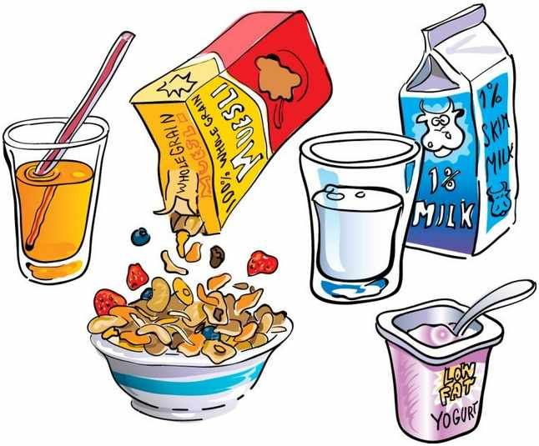
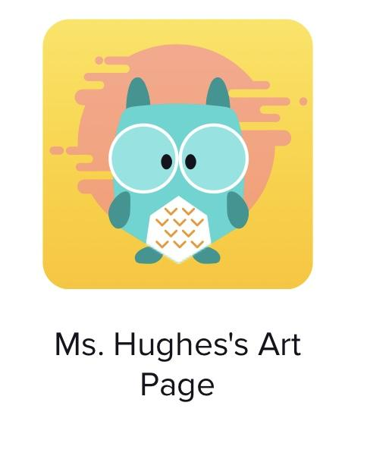
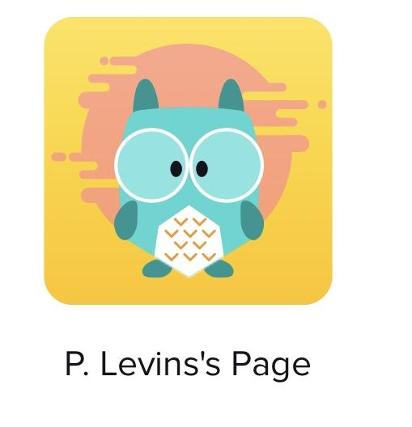
2nd Grade Virtual Learning MORNING Schedule
Time | Subject | Link or Resource Information
8:00-8:15 8:35-9:00 | Breakfast Morning Meeting/Microsoft Teams
9:30-10:05am | Reading/Writing
10:05-10:25am | Phonics/Spelling | Spelling Menu available on class tag and my class page
10:25am – 10:35am | Brain Break
10:35 -11:05am | Gym or Art Gym – Mon, Wed, Fri. Art – Tues and Thurs
11:05am-11:35 | Science/SS | Class code: wcl6967
11:35am – 12:35pm | Math
11:30-12:30 | Lunch Time

Slide 11
2nd Grade Virtual Learning AFTERNOON Schedule
Time | Subject | Link or Resource Information
12:30-12:40: 12:40-1:00 2pm-2:30pm | Community Meeting/Afternoon Snack (working snack) | Story Time/Math Continued
2:30-3:05pm | D.E.A.R Time Response/Discussion
3:05-3:25pm | Brain Break | Spelling Menu available on class tag and my class page
 |  | Class code:
5:30 pm | Dinner Time Read/ Play outdoors/indoors Get a good nights rest

Slide 12
Class Rules
1. Be respectful
2. Be kind
3. Always try your BEST

Slide 13
*Each morning: nutritious breakfast, gather materials
*Make sure workspace is free of noise and distractions. *Proper attire (no pajamas)
*Device is set up and charged
*Students should log-in by 8:35 AM: ATTENDANCE IS COUNTED & TAKEN DAILY!
*Completed work submitted via Class Dojo Portfolio
*Independent Reading, Writing & Math practice daily
*Join Special Area teachers on time (see prep schedule)

Slide 14
Contact Us through Class Dojo or E-mail, and be sure to frequently visit our class homepages:
*Mrs. D’Onofrio: Adonofrio@yonkerspublicschools.org
https://www.yonkerspublicschools.org/domain/2288
*Ms.Aponte:
Eaponte@yonkerspublicschools.org
https://www.yonkerspublicschools.org/site/Default.aspx?PageID=28810

Slide 15
Thank.You !

